Slide 1
Data Preprocessing
Lecturer: Dr. Bo Yuan
E-mail: yuanb@sz.tsinghua.edu.cn

Slide 2
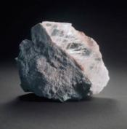
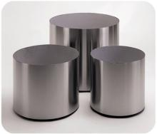
Outline
Data Cleansing
Data Transformation
Data Description
Feature Selection
Feature Extraction

Slide 3
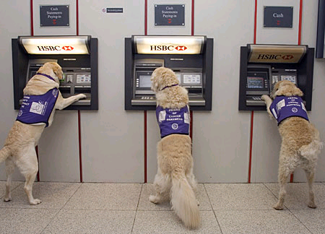

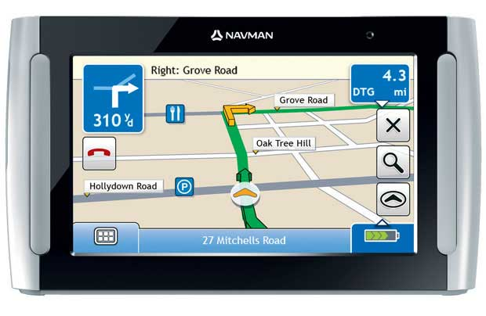

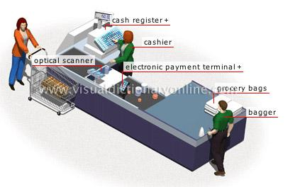
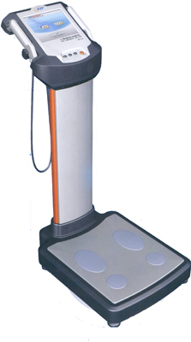
Where are data from?

Slide 4

Why Data Preprocessing?
Real data are notoriously dirty!
The biggest challenge in many data mining projects
Incomplete
Occupancy = “ ”
Noisy
Salary = “-100”
Inconsistent
Age = “42” vs. Birthday = “01/09/1985”
Redundant
Too much data or too many features for analytical analysis
Others
Data types
Imbalanced datasets

Slide 5

Missing Data
Data are not always available.
One or more attributes of a sample may have empty values.
Many data mining algorithms cannot handle missing values directly.
May cause significant troubles.
Possible Reasons
Equipment malfunction
Data not provided
Not Applicable (N/A)
Different Types
Missing completely at random
Missing conditionally at random
Not missing at random

Slide 6

How to handle missing data?
Ignore
Remove samples/attributes with missing values
The easiest and most straightforward way
Work well with low missing rates
Fill in the missing values manually
Recollect the data
Domain knowledge
Tedious/Infeasible
Fill in the missing values automatically
A global constant
The mean or median
Most probable values
More art than science

Slide 7
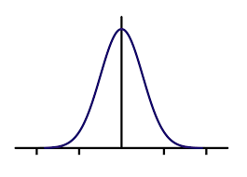
Missing Data: An Example
P(Y|X)
M_Y
Y
M_Y
M_Y
X
Notes:
某个点，（x0, —）,即y缺失，可以：
1、取x=x0的所有y值的平均值作为y值
2、根据已知的x=X0的所有y值得到一个函数（如正态分布），取其上的某点作为y值

Slide 8
Outliers
Outliers
y
y = x + 1
x
Notes:
离群点，比较难处理的点，会影响结果

Slide 9

Outliers
Outliers

Slide 10
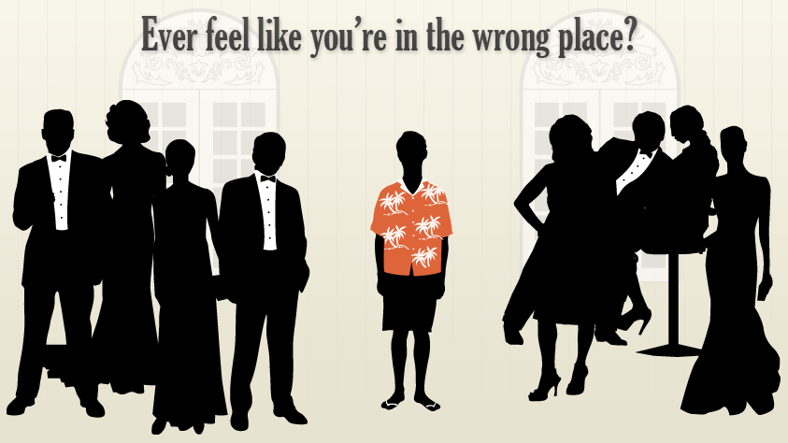
Anomaly vs. Outlier
Notes:
异常点并不等同于离群点

Slide 11


Slide 12
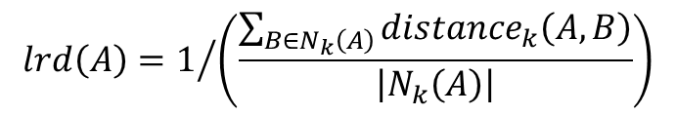
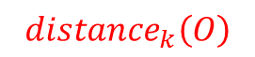
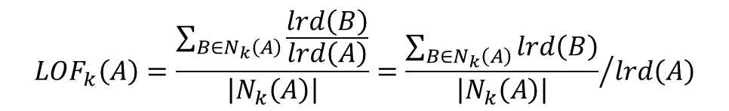
Local Outlier Factor
$${distance}_{k}\left(O\right)$$
k=3
p₂
o
p₁
$${distance}_{k}\left(A,B\right)=max\left\{{distance}_{k}\left(B\right),d\left(A,B\right)\right\}$$
p₃
p₄
$$lrd\left(A\right)=1/{\left(\frac{\sum_{B∈N_{k}\left(A\right)}{{distance}_{k}\left(A,B\right)}}{\left|N_{k}\left(A\right)\right|}\right)}$$
$${LOF}_{k}\left(A\right)=\frac{\sum_{B∈N_{k}\left(A\right)}{\frac{lrd\left(B\right)}{lrd\left(A\right)}}}{\left|N_{k}\left(A\right)\right|}={\frac{\sum_{B∈N_{k}\left(A\right)}{lrd\left(B\right)}}{\left|N_{k}\left(A\right)\right|}}/{lrd\left(A\right)}$$
Notes:
Local Outlier Factor --- 离群点检测的一个算法，基本思想是基于局部密度（k个近邻，用距离来表示局部密度）。通过比较一个点和它周围点的密度，确定相同密度的区域，以及密度远低于该区域密度的那些点，被判断为离群点
离群是一个相对的概念
${distance}_{k}\left(O\right)$：o点到它的k个近邻的最大距离，包含了在这个范围内的所有点
K=3, 表示取3个近邻，如果两个点到o点的距离相同，只计算一个。所以实际的点数可能比k大
在实际中，公式中可以根据各种概念具体采用不同计算公式，但基本思想都是“相对距离”
${distance}_{k}\left(A,B\right)=max\left\{{distance}_{k}\left(B\right),d\left(A,B\right)\right\}$ ：可达距离，B点到A点的真实距离，A的k个近邻的最大距离取大值。
Lrd(A)：A的区域密度，从A的近邻到A的可达距离的平均值的倒数
$N_{k}\left(A\right)$ A的k个近邻
注意，是从B到A的“可达距离” ${distance}_{k}\left(A,B\right)$，不是A的近邻距离${distance}_{k}\left(A\right)$
${LOF}_{k}\left(A\right)$：A的k个近邻的区域密度平均值，与A本身的区域密度的比
< 1, A更密集
> 1 且足够大，A是outlier

Slide 13
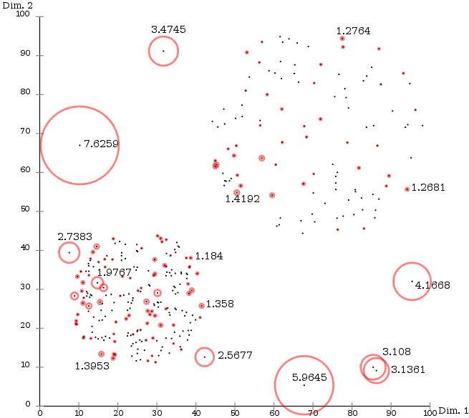
Local Outlier Factor
Notes:
每个圈中的数字就是LOF值，越大表示是离群点的概率越大

Slide 14
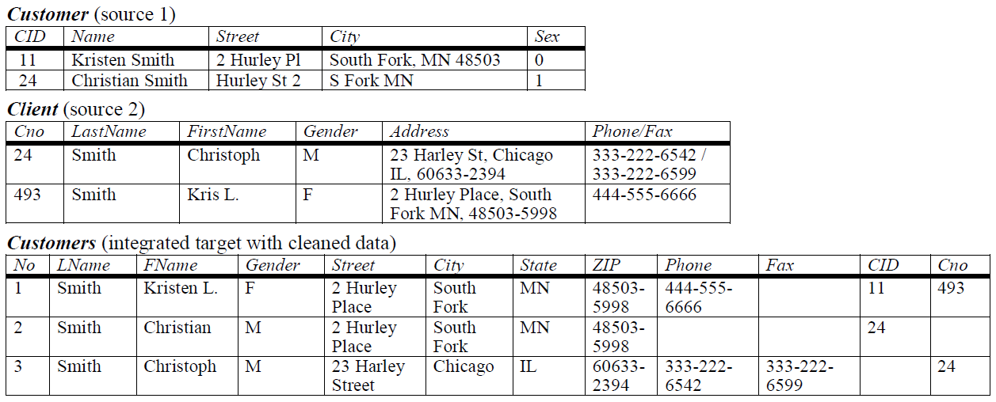
Duplicate Data
Notes:
合并不同数据集：Sorted-Neighborhood Method（阅读材料1的笔记）

Slide 15
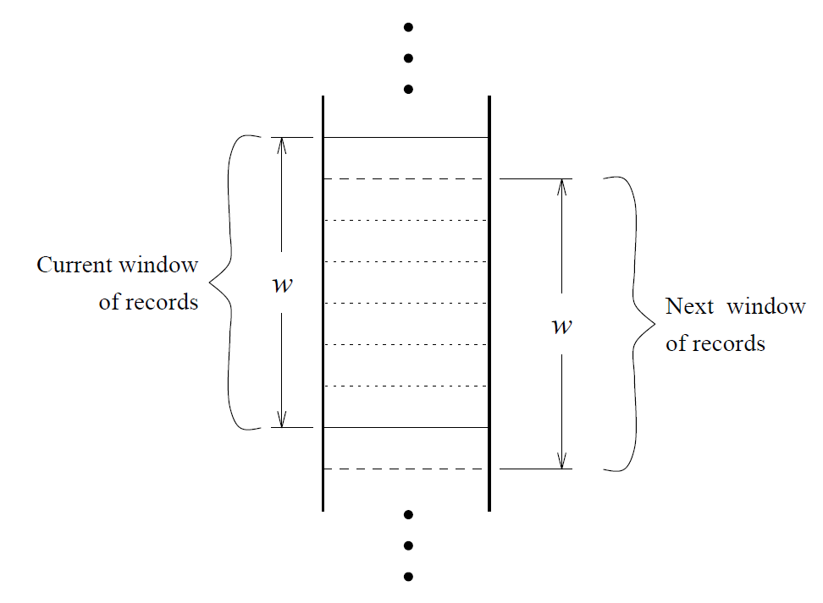
Duplicate Data
Notes:
滑动窗口内记录进行比较

Slide 16
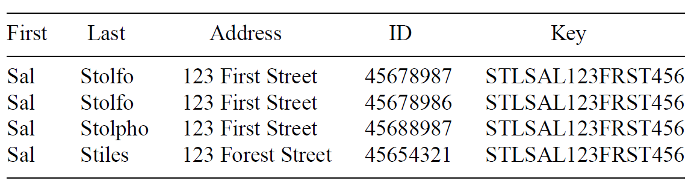
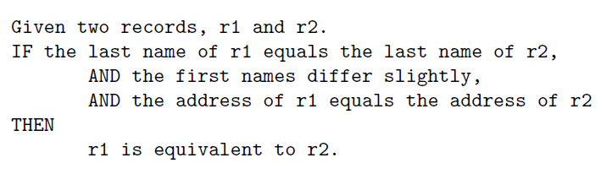
Duplicate Data
Create Keys
Sort
Merge
Notes:
判断规则

Slide 18
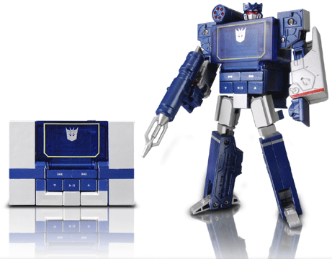
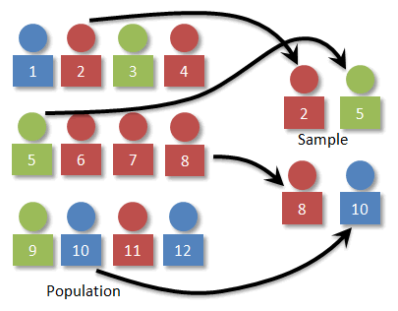
Data Transformation
Now we have an error free dataset.
Still needs to be standardized.
Type Conversion
Normalization
Sampling

Slide 19
Attribute Types
Continuous
Real values: Temperature, Height, Weight …
Discrete
Integer values: Number of people …
Ordinal
Rankings: {Average, Good, Best}, {Low, Medium, High} …
Nominal
Symbols: {Teacher, Worker, Salesman}, {Red, Green, Blue} …
String
Text: “Tsinghua University”, “No. 123, Pingan Avenue” …

Slide 20
Type Conversion
×
○
×
×
○
×
Size
○
×
○
○
×
○
Color
Notes:
这样实际增加了一个隐含的假设：绿点到红点的距离 < 蓝点到红点的距离
这种假设有时候可能会使得问题更简单，有时可能会使得问题更复杂

Slide 21
Type Conversion
×
×
○
×
×
○
Size
○
○
×
○
○
×
Color

Slide 22
Type Conversion
0 0 0 1
0 0 1 0
0 1 0 0
1 0 0 0

Slide 23
Sampling
A database/data warehouse may store terabytes of data.
Processing limits: CPU, Memory, I/O …
Sampling is applied to reduce the time complexity.
In statistics, sampling is applied often because obtaining the entire set of data is expensive.
Aggregation
Change of scale:
Cities → States; Days → Months
More stable and less variability
Sampling can be also used to adjust the class distributions.
Imbalanced dataset
Notes:
Aggregation：聚集、聚合。改变数据的层级，减小数据
Imbalanced dataset: 很多分类算法在不平衡的数据上，可能会犯错误，所以需要通过sampling去调整数据的比例

Slide 24
Imbalanced Datasets
LHS RHS
10%
5%
85%
Classifier A
Classifier B
Notes:
不平衡数据上的两个分类器A和B， acc(A)=95%, acc(B)=85%，但是对少量数据分类来说，A是比较糟糕的 --- 不平衡的数据集的问题
不平衡时，整体精度高不一定好，需要同时兼顾 两方准确率

Slide 25
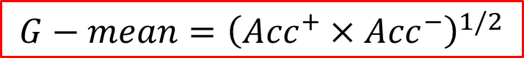
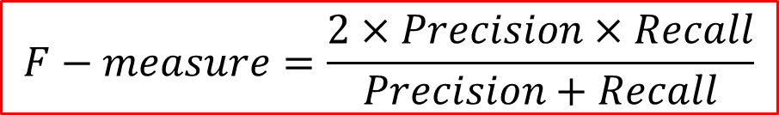
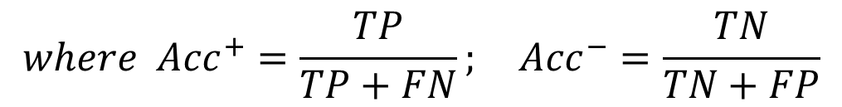
Imbalanced Datasets
$$G−mean={\left({Acc}^{+}×{Acc}^{−}\right)}^{1/2}$$
$$where {Acc}^{+}=\frac{TP}{TP+FN}; {Acc}^{−}=\frac{TN}{TN+FP}$$
$$F−measure=\frac{2×Precision×Recall}{Precision+Recall}$$
$$where Precision=\frac{TP}{TP+FP}; Recall=\frac{TP}{TP+FN}={Acc}^{+}$$
Notes:
不平衡时，整体精度高不一定好，需要同时兼顾 两方准确率

Slide 26
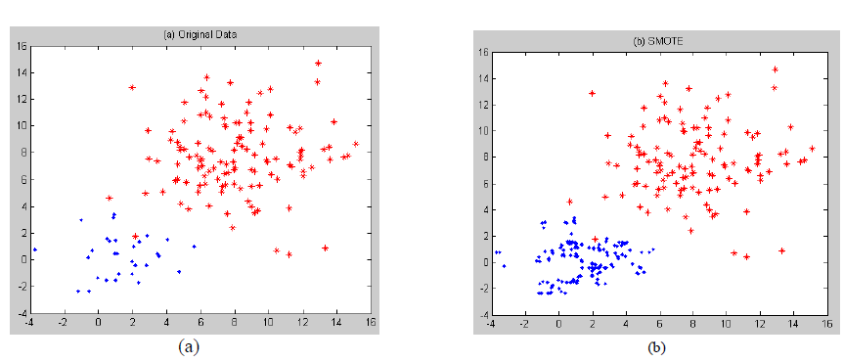
Over-Sampling
SMOTE
Notes:
兰颜色的点比红颜色的点少很多：增加蓝色的点。但不能简单的复制，而是通过差值的方法、生成具有一定随机性的点

Slide 27
Boundary Sampling
Notes:
边缘点的贡献，大于中间点。如果数据量很大，机器跑不动时，可以考虑取出边缘点代替整个数据集参与计算

Slide 29
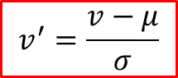
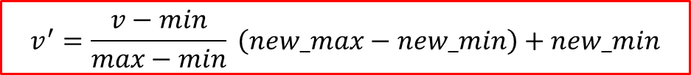
Normalization
The height of someone can be 1.7 or 170 or 1700 …
Min-max normalization:
Let income range $12,000 to $98,000 be normalized to [0.0, 1.0]. Then $73,600 is mapped to
Z-score normalization (μ: mean, σ: standard deviation):
Let μ = 54,000, σ = 16,000. Then
$$v^{′}=\frac{v−min}{max−min} \left(new_max−new_min\right)+new_min$$
$$v^{′}=\frac{v−μ}{σ}$$

Slide 30
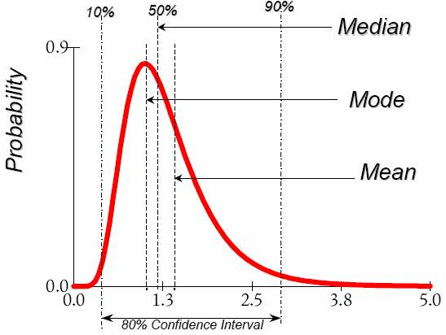
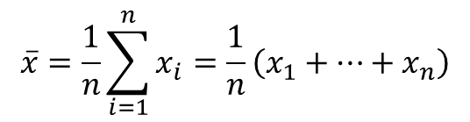
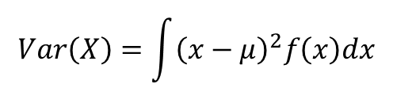
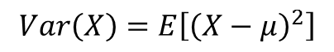
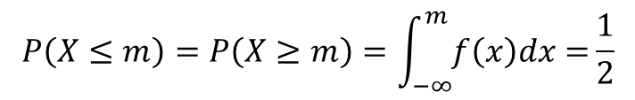
Data Description
Mean
Arithmetic mean
Median
Mode
The most frequently occurring value in a list
Can be used with non-numerical data.
Variance
Degree of diversity
$$\overline{x}=\frac{1}{n}\sum_{i=1}^{n}{x_{i}}=\frac{1}{n}\left(x_{1}+…+x_{n}\right)$$
$$P\left(X≤m\right)=P\left(X≥m\right)=\int_{−∞}^{m}{f\left(x\right)dx=}\frac{1}{2}$$
$$Var\left(X\right)=\int{{\left(x−μ\right)}^{2}f\left(x\right)dx}$$
$$Var\left(X\right)=E\left[{\left(X−μ\right)}^{2}\right]$$

Slide 31
Data Description
Pearson’s product moment correlation coefficient
If r_{A, B} > 0, A and B are positively correlated.
If r_{A, B} = 0, no linear correlation between A and B.
If r_{A, B} < 0, A and B are negatively correlated.
Notes:
相关系数
相关系数有一个明显的缺点，即它接近于1的程度与数据的数量n有关。
当n较小时，相关系数的波动较大，对有些样本相关系数的绝对值易接近于1；
当n较大时，相关系数的绝对值容易偏小。
特别是当n=2时，相关系数的绝对值总为1。
因此在样本容量n较小时，我们仅凭相关系数较大就判定变量x与y之间有密切的线性关系是不妥当的。

Slide 32
Data Description
Pearson's chi-square (χ²) test
 | Play chess | Not play chess | Sum (row)
Like science fiction | 250 (90) | 200 (360) | 450
Not like science fiction | 50 (210) | 1000 (840) | 1050
Sum (col.) | 300 | 1200 | 1500
Notes:
chi-square：卡方检验，可用于检验：将chi-square的计算值查表，获得p-value
(1)检验某个连续变量的分布是否与某种理论分布相一致。如是否符合正态分布、是否服从均匀分布、是否服从Poisson分布等。
假定分布成立，可得期望值，然后比较测算观察值和期望值的差异
(2)检验某个分类变量各类的出现概率是否等于指定概率。如在36选7的彩票抽奖中，每个数字出现的概率是否各为1／36；掷硬币时，正反两面出现的概率是否均为0．5。
(3)检验某两个分类变量是否相互独立。如吸烟(二分类变量：是、否)是否与呼吸道疾病(二分类变量：是、否)有关；产品原料种类(多分类变量)是否与产品合格(二分类变量)有关。
(4)检验控制某种或某几种分类因素的作用以后，另两个分类变量是否相互独立。如在上例中，控制性别、年龄因素影响以后，吸烟是否和呼吸道疾病有关；控制产品加工工艺的影响后，产品原料类别是否与产品合格有关。
(5)检验某两种方法的结果是否一致。如采用两种诊断方法对同一批人进行诊断，其诊断结果是否一致；采用两种方法对客户进行价值类别预测，预测结果是否一致。

Slide 33
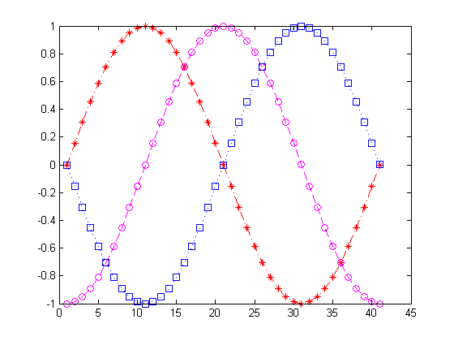
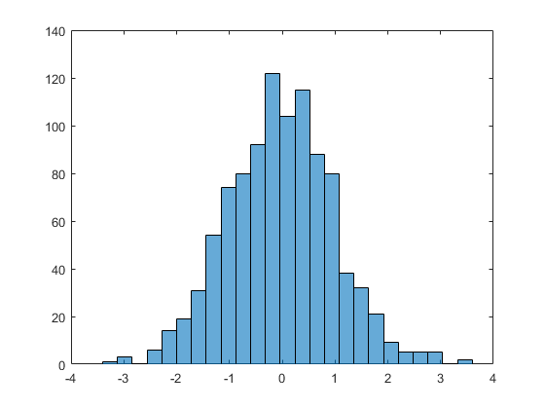
Data Visualization (1D)

Slide 34
Data Visualization (2D)
Notes:
load carsmall
plot(Displacement, Acceleration,'ro')
regress(Acceleration,[ones(100,1),Displacement])
hold on
line([0,19.35/0.021],[19.35,0])

Slide 35
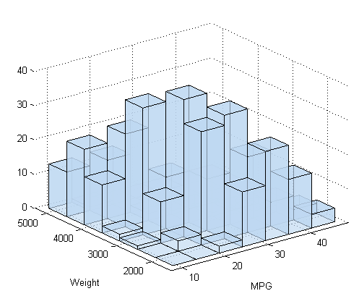
Surf Plots (3D)
Notes:
[X,Y]=meshgrid(-3:0.1:3,-3:0.1:3);
Z=peaks(X,Y);
surfc(X,Y,Z);
shading interp
colormap(gray);

Slide 36
Box Plots (High Dimensional)
Notes:
S=diag([1,2,0.5,1])
M=[0,1,3,-1];
Z=mvnrnd(M,S,10000);
boxplot(Z);

Slide 37
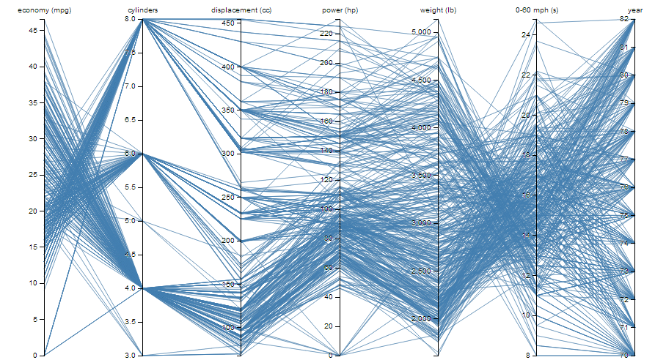
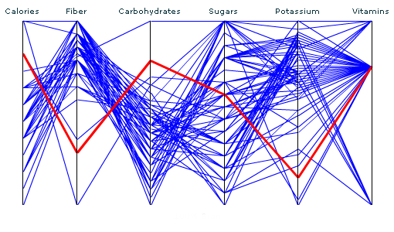
Parallel Coordinates (High Dimensional)

Slide 38
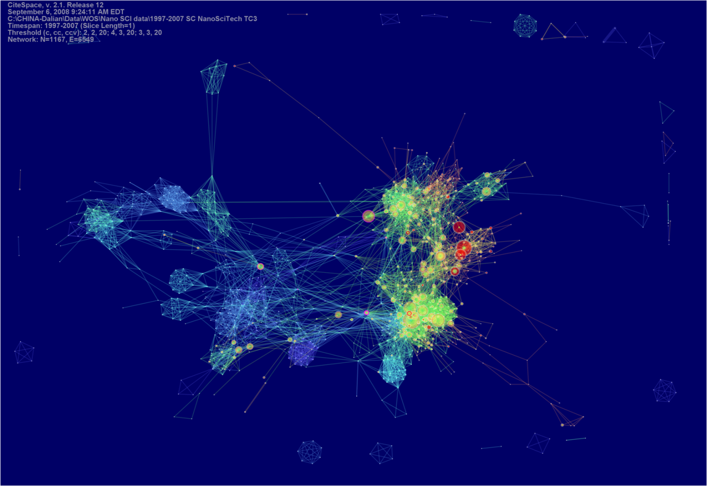
CiteSpace

Slide 39
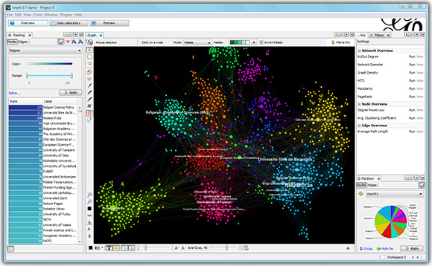
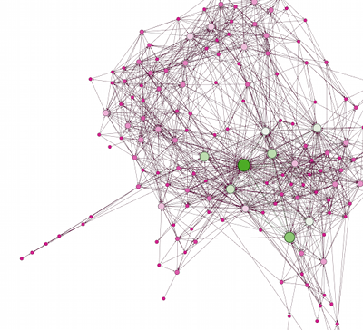
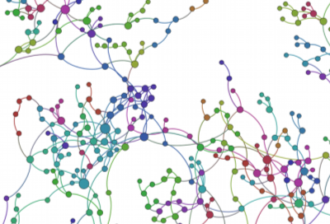
Gephi

Slide 41
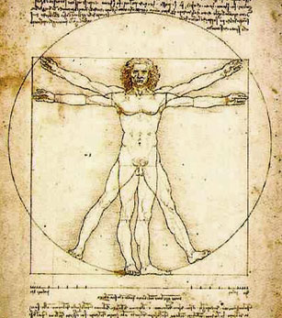
Feature Selection
ID
Weight
Age
Noisy?
Gender
Height
Irrelevant?
Education
Duplicate?
Income
Address
Complexity?
Location
Occupation

Slide 42
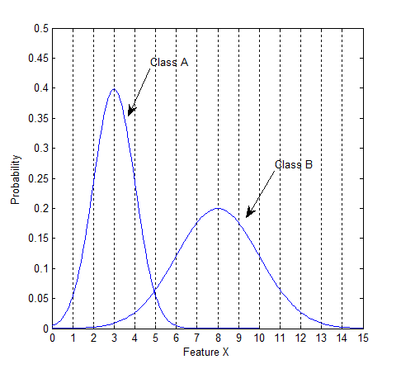
Class Distributions
Notes:
一个属性好不好，要看它的区分度，最好是能将100%的将两类目标分开

Slide 43
Class Distributions

Slide 44
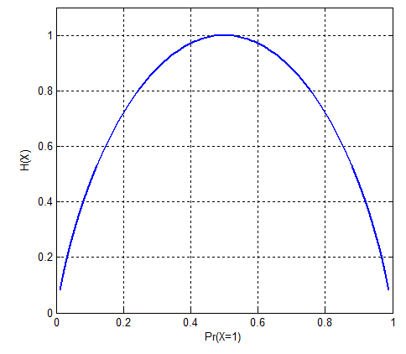
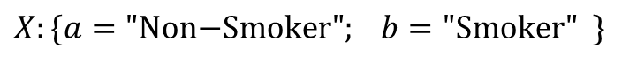
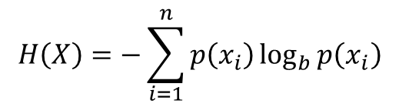
Entropy（熵，平均信息量）
$$H\left(X\right)=−\sum_{i=1}^{n}{p\left(x_{i}\right)\log_{b}{p\left(x_{i}\right)}}$$
$$X:\{a="\text{Non}\text{−}\text{Smoker}"; b=\text{"}\text{Smoker}" \}$$
Information Gain
Notes:
a: Non-Smoker (60%) 80% Female 20% Male
b: Smoker (40%) 5% Female 95% Male
Information Gain越大，说明该属性使得不确定性降低越多，效能越高。

Slide 45
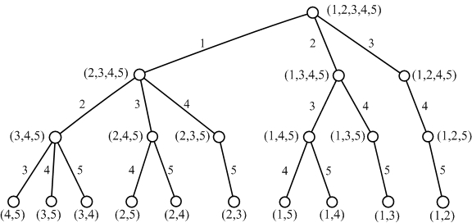
Feature Subset Search
Exhaustive
All possible combinations
Branch and Bound

Slide 46

Feature Subset Search
Top K Individual Features
Sequential Forward Selection
Sequential Backward Selection
Optimization Algorithms
Simulated Annealing
Tabu Search
Genetic Algorithms

Slide 48

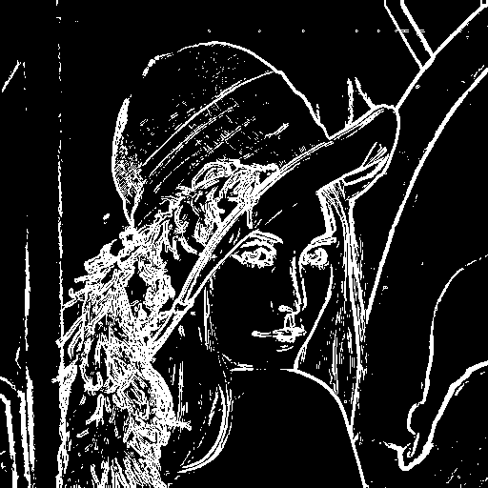
Feature Extraction

Slide 49

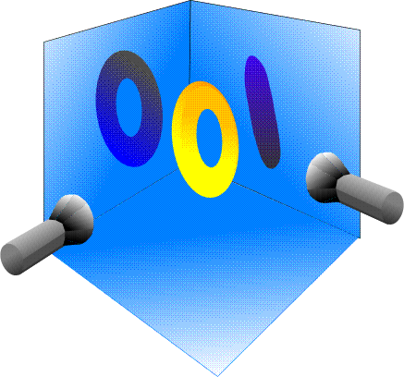
Principal Component Analysis

Slide 50
2D Example
Data: Gaussian Distribution
Variance: Information
Ellipse: Major Axis vs. Minor Axis
Select the attribute corresponding to the Major Axis.
Minor
Major
Feature X₂
Feature X₁
Notes:
高斯分布可以用一个椭圆括起来。
椭圆有长轴和短轴，一个属性分布越广则它所含的信息就越多。所有长轴方向的属性很信息多

Slide 51
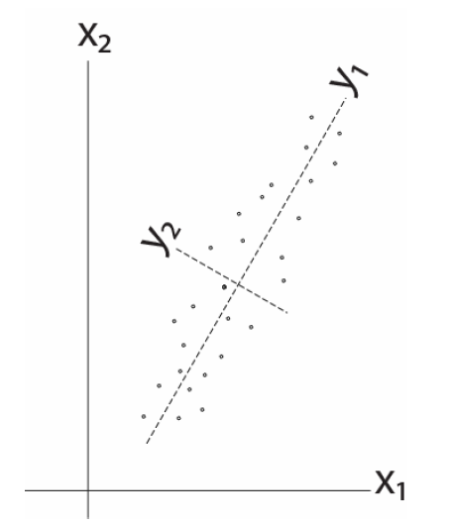
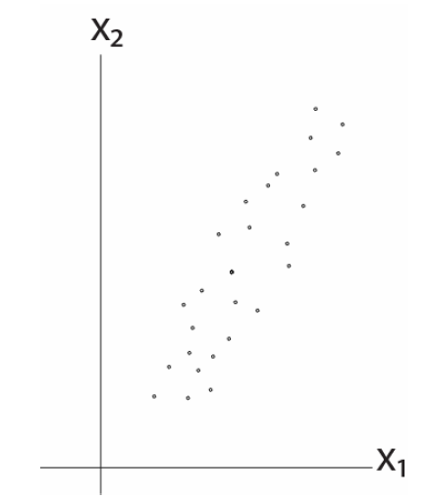
2D Example

Slide 52
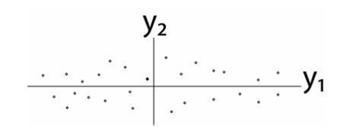
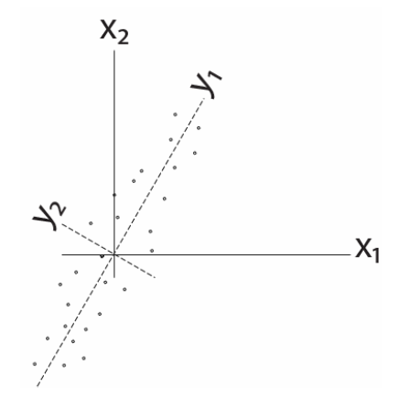


2D Example
Remove correlation

Slide 53






Some Math
Goal: S(Y) has nonzero diagonal entries and all off-diagonal elements are zero.
Eigendecomposition

Slide 54












A Different View
$$x_{k}$$
e
$$J\left(e\right)=\sum_{i=1}^{n}{{\left\|{x_{k}^{}}^{′}−x_{k}\right\|}^{2}}$$
$$α_{k}=e^{t}x_{k}$$
$${x_{k}^{}}^{′}$$
$$\left\|e\right\|=1$$
$$=\sum_{i=1}^{n}{{\left\|α_{k}e−x_{k}\right\|}^{2}}$$
$$α_{k}$$
$$=\sum_{i=1}^{n}{{α_{k}}^{2}{\left\|e\right\|}^{2}}−2\sum_{i=1}^{n}{α_{k}e^{t}x_{k}}+\sum_{i=1}^{n}{{\left\|x_{k}\right\|}^{2}}$$
$$=−\sum_{i=1}^{n}{{α_{k}}^{2}}+\sum_{i=1}^{n}{{\left\|x_{k}\right\|}^{2}}$$
$$\max_{e}{e^{t}Se s.t. \left\|e\right\|=1}$$
$$=−\sum_{i=1}^{n}{e^{t}x_{k}{x_{k}^{}}^{t}e}+\sum_{i=1}^{n}{{\left\|x_{k}\right\|}^{2}}$$
$$S=\sum_{i=1}^{n}{x_{k}{x_{k}^{}}^{t}}$$
Notes:
二维降到一维度：投影前X，投影后X‘，距离（也就是差异）尽可能小，这样信息丢失尽可能小

Slide 55


Lagrange Multipliers

Slide 56



More Math ...
eigenvector
eigenvalue
PCA
To project the original data to the eigenvectors of S with the largest eigenvalues.
$$\left[\begin{matrix}2 & 1 \\ 1 & 2\end{matrix}\right]\left[\begin{matrix}1 \\ 1\end{matrix}\right]=\left[\begin{matrix}3 \\ 3\end{matrix}\right]=3\left[\begin{matrix}1 \\ 1\end{matrix}\right]$$
$$\left[\begin{matrix}2 & 1 \\ 1 & 2\end{matrix}\right]\left[\begin{matrix}1 \\ −1\end{matrix}\right]=\left[\begin{matrix}1 \\ −1\end{matrix}\right]$$

Slide 57


PCA Examples
Notes:
用matlab进行PCA的基本过程

Slide 58





Fish

Slide 59


Fish

Slide 61

The Issue of PCA
Now, let’s consider class information ...
Notes:
PCA会将数据投影到长轴上，如果是分类问题，两个系列的数据就分不出来了
PCA是非监督性问题，不适用于有标签的数据。有标签的数据，可使用LDA进行降维

Slide 62

Linear Discriminant Analysis
The objective of LDA is to perform dimension reduction while preserving as much of the class discriminatory information as possible.
Given a set of d-D vectors x₁, x₂, ..., x_{n} of which N₁ belong to ω₁, and N₂ to ω₂. Of all the possible projection lines y=w^{T}x, find the one that maximizes the separability.
Notes:
LDA也是通过投影降维，选择投影方向 --》不同的分组之间距离尽可能远

Slide 63


Measure of Separability

Slide 64


Fisher Criterion
Maximize the distance between classes
Minimize the scatter within each class
Notes:
J值越大越好

Slide 65






Some Math …
between-class scatter
within-class scatter
Notes:
从Si与cov（X）的公式，可得：Si = cov(Xi) * (n-1) --- n为数据分类Xi中数据个数

Slide 66


More Math...
generalized Rayleigh quotient

Slide 67


More Math...
eigenvector problem!
scalar

Slide 69

LDA Example
Dataset
$C1=\left[\left(1,2\right);\left(2,3\right);\left(3,3\right);\left(4,5\right);(5,5)\right]$
$C2=\left[\left(1,0\right);\left(2,1\right);\left(3,1\right);\left(3,2\right);\left(5,3\right);(6,5)\right]$
Covariance of [c1; c2]
$Z=\left[\begin{matrix}2.7636 & 2.2545 \\ 2.2545 & 3.0182\end{matrix}\right]$
Eigenvectors and Eigenvalues of Z
$V=\left[\begin{matrix}−0.7268 & 0.6869 \\ 0.6869 & 0.7268\end{matrix}\right]$
$D=\left[\begin{matrix}0.6328 & 0 \\ 0 & 5.1490\end{matrix}\right]$
The direction of PCA projection: ${\left[0.6869, 0.7268\right]}^{T}$
Notes:
这张图，计算PCA：
PCA是不考虑标签信息的，所以计算PCA的时候，要将数据集C1、C2混合在一起，计算协方差矩阵，
cov(x,x) cov(x,y)
cov(y,x) cov(y,y)
2. D中选出大的值5.14，对应的V向量（0.6869,0.7268）T，就是PCA的方向

Slide 70

LDA Example
The mean of each class
$μ_{1}=mean\left(c1\right)={\left[3.0, 3.6\right]}^{T}$
$μ_{2}=mean\left(c2\right)={\left[3.3, 2.0\right]}^{T}$
$S_{B}={\left(μ_{1}−μ_{2}\right)\left(μ_{1}−μ_{2}\right)}^{T}$=$\left[\begin{matrix} 0.11 & −0.53 \\ −0.53 & 2.56\end{matrix}\right]$
The scatter of each class
$S_{1}=4×cov\left(c1\right)=\left[\begin{matrix}10 & 8 \\ 8 & 7.2\end{matrix}\right]$
$S_{2}=5×cov\left(c2\right)=\left[\begin{matrix}17.3 & 16 \\ 16 & 16\end{matrix}\right]$
$S_{w}=S_{1}+S_{2}=\left[\begin{matrix}27.3 & 24 \\ 24 & 23.2\end{matrix}\right]$
Notes:
这张图是计算LDA：
1. 数据集C1，C2是要分开的
2. S1, S2分别是C1，C2的散布矩阵，等于数据集C1、C2的协方差矩阵 * （样本个数 - 1）
从Si与cov（X）的公式，可得：Si = cov(Xi) * (n-1) --- n为数据分类Xi中数据个数

Slide 71

LDA Example
${S_{w}}^{−1}S_{B}=\left[\begin{matrix}0.26 & −1.27 \\ −0.30 & 1.42\end{matrix}\right]$
Eigenvectors and Eigenvalues of ${S_{w}}^{−1}S_{B}$
$V=\left[\begin{matrix}−0.98 & 0.67 \\ −0.20 & −0.75\end{matrix}\right]$
$D=\left[\begin{matrix}0 & 0 \\ 0 & 1.69\end{matrix}\right]$
The direction of LDA projection: ${\left[0.6656, −0.7463\right]}^{T}$
Alternatively
${S_{w}}^{−1}{\left(μ_{1}−μ_{2}\right)}^{T}={\left[−0.7936, 0.8899\right]}^{T}$
After normalization: ${\left[−0.6656, 0.7463\right]}^{T}$

Slide 72
LDA Example

Slide 73

C-Class LDA
Notes:
对于多分类问题（分类数C > 2），类似二分类问题。
SB公式中，u是所有样本的平均值u，Ni是Ci中样本的个数

Slide 74

C-Class LDA
For C-class LDA with C=2, S_{B} is defined as:

Slide 75
C-Class LDA
N1=1000; N2=500; N3=2000;
X1=mvnrnd([0,0], [1,0;0,1], N1);
X2=mvnrnd([3,6], [1,-0.8;-0.8,1], N2);
X3=mvnrnd([10,6], [1,0.8;0.8,1], N3);
S1=(N1-1)*cov(X1); S2=(N2-1)*cov(X2); S3=(N3-1)*cov(X3);
Sw=S1+S2+S3;
M1=mean(X1); M2=mean(X2); M3=mean(X3);
Mu=(N1*M1+N2*M2+N3*M3)/(N1+N2+N3);
Sb=N1*(M1-Mu)'*(M1-Mu)+N2*(M2-Mu)'*(M2-Mu) +N3*(M3-Mu)'*(M3-Mu);
J=inv(Sw)*Sb; [V,D]=eig(J);
Notes:
Matlab代码
假设原数据有n个分类，LDA最多可以投影到n-1个维度上，但是这些维度不一定正交

Slide 76




Limitations of LDA
LDA produces at most C-1 projections
S_{B} is a matrix with rank C-1 or less.
S_{W} may be singular.
LDA does not work well when ...
Notes:
LDA均值相等时，无论怎么投效果都不好。

Slide 77
Reading Materials
M. A. Hernandez and S. J. Stolfo, “Real-World Data is Dirty: Data Cleansing and The Merge/Purge Problem,” Data Mining and Knowledge Discovery, vol. 2, pp. 9–37, 1998.
A. Donders, G. van der Heijden, T. Stijnen, and K. Moons, “Review: A Gentle Introduction to Imputation of Missing Values,” Journal of Clinical Epidemiology, vol. 59, pp. 1087-1091, 2006.
N. V. Chawla, K. W. Bowyer, L. O. Hall and W. P. Kegelmeyer, “SMOTE: Synthetic Minority Over-Sampling Technique,” Journal of Artificial Intelligence Research, vol. 16, pp. 321–357, 2002.
---- Imbalance
N. Japkowicz and S. Stephen, “The Class Imbalance Problem: A Systematic Study,” Intelligent Data Analysis, vol. 6, pp. 429–449, 2002.
D. Keim, “Information Visualization and Visual Data Mining,” IEEE Transactions on Visualization and Computer Graphics, vol. 8, pp. 1-8, 2002.
PCA Tutorials
http://www.cs.princeton.edu/picasso/mats/PCA-Tutorial-Intuition_jp.pdf
http://www.cs.otago.ac.nz/cosc453/student_tutorials/principal_components.pdf
Lagrange Multipliers
http://diglib.stanford.edu:8091/~klein/lagrange-multipliers.pdf

